Slide 1
EFM: (Pseudo-)Ensembled First Mismatch
Flip order of nodes in each layer
(5,5,2) Dense Network
FM:
1
2
3
4
5
1
2
3
4
5
1
2
Weight = 3/12
FM:
2
3
4
5
1
2
3
4
5
2
1
Weight = 1/12
But network hasn’t changed….

Slide 2
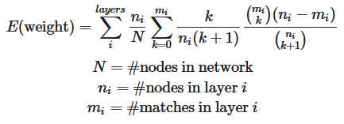
EFM: (Pseudo-)Ensembled First Mismatch
If we repeat this experiment many times:
Draw until mismatch occurs
Put all nodes in layer in “bucket”
stop summation at first mismatched layer
Repeat with each layer until first mismatch, then stop

Slide 3
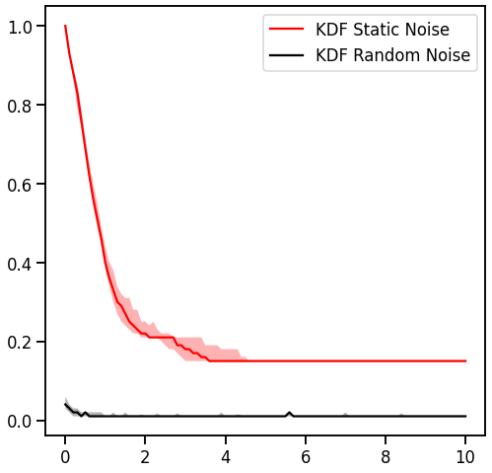
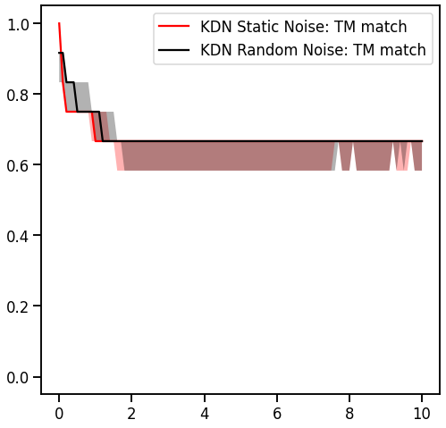
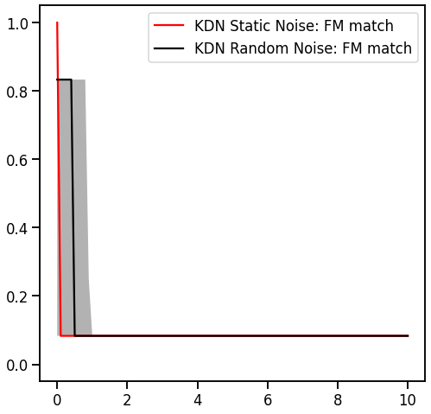
Distance vs Weight: Gaussian Sparse Parity
Evaluated on Gaussian Sparse Parity (S3, N17) dataset
(5,5,2) network

Slide 4
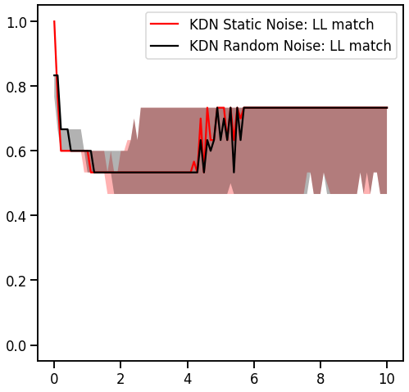
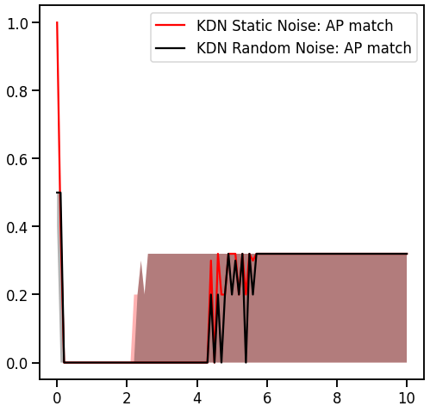
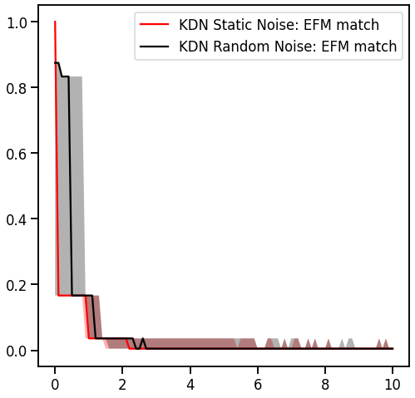
Distance vs Weight: Gaussian Sparse Parity
Evaluated on Gaussian Sparse Parity (S3, N17) dataset
(5,5,2) network

Slide 5
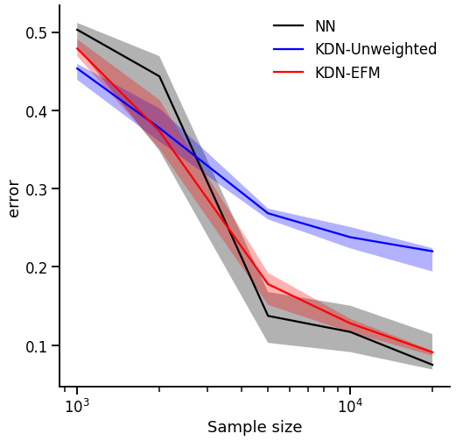
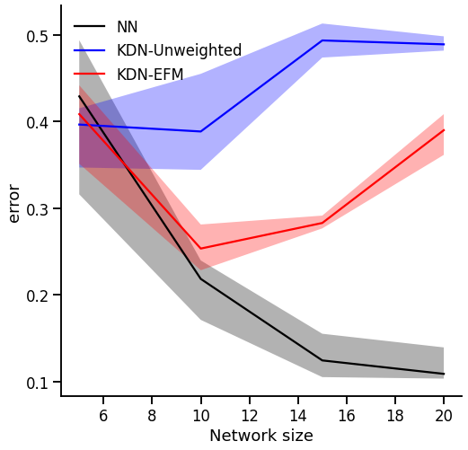
KDN-EFM accuracy: Gaussian Sparse Parity
GSP (S3, N17) dataset, k samples, (5, 5, 2) network
GSP (S3, N17) dataset, 2000 samples, (n, n, 2) network

Slide 6
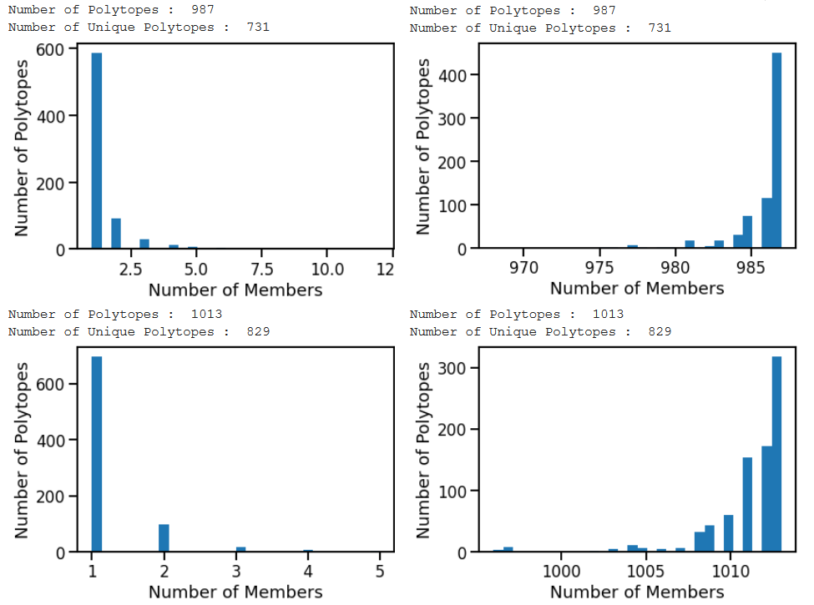
Unweighted KDN EFM Weighted
KDN-EFM Polytope Size: Gaussian Sparse Parity
(S3, N17) (5, 5, 2 network) Polytope size, including weights

Slide 7
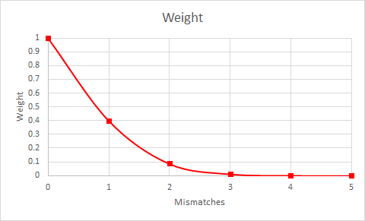
Example weights for 5-node layer
Matches | Mismatches | Weight | E(Nodes Drawn)
5 | 0 | 1 | 5
4 | 1 | 0.4 | 2
3 | 2 | 0.087 | 0.433
2 | 3 | 0.012 | 0.058
1 | 4 | 0.001 | 5.56E-03
0 | 5 | 0 | 0

